Slide 1

Take A Minute to Play
AATH 2020 Conference: Mary Kay Morrison
Notes:
Thank you Mallori. I am really happy to be able to share a fun and vital part of my life.– as you saw in the video---I believe in the The power of play!
Some of you may know, my first job was as kindergarten teacher who was devasted when informed that I had to cut back on play activities and put more serious stuff in the curriculum.
This early challenge in my career led to a lifelong determination to learn more about how we learn. This interest in play led to my attendance at an AATH conference in Chicago on humor in education.

Slide 2
Play:
Vital For Brain Development
Notes:
Of course what I learned over many years of study, is that play is vital for brain development.
There is a dedicated “play” circuitry in the brain equivalent to the circuits of fear and love. (Jake Panksepp Discover, April 2003)
In studies of juvenile rats, it was found that play contributes to how memory is formed in the brain. In The longer the period of play for mammals---the more intelligent. And of course humans have an extended play period.
It has been found that a lack of play can actually stunt growth. Play is vital for brain development.

Slide 3
The Impact of Play on Brain Development
CAGE
CAGE
CAGE
CAGE
No Stimulation
Toys
Friends
Toys and Friends
In the WILD
Neural Connections Increase
Using Humor to Maximize Living
Morrison (2012)
Notes:
A closer look. Speaking of those rats………
As you can see….Researchers have tried a variety of ways to measure what happened in the brains of rats when exposed to various environments.
Being in the wild is the best choice…..so free play is one of the BEST ways to learn. What kind of cages to we put kids into? Having just devices without relationships will stunt brain development. The same is true for adults.
Is our productifvity is stunted when we are limited to time on our devices?

Slide 4
Benefits of Play
Communication skills
Cognitive Development
Physical Development
Creativity
A TRIGGER FOR LAUGHTER
Notes:
Play is important---not just for kids…..
Play promotes social bonding, critical thinking, risk-taking and of course creativity.
And as AATH members know, it contributes to building a foundation for humor development.
Play and playfulness are triggers for laughter. Both are integral to humor.
--Playful Intelligence by Anthony DeBenedet He reviews the important attributes of play including Imagination, Wonder, Spontaneity, Sociability and Humor as components of playful intelligence.
Imagine how fun it was when I read his book and found the story about our very own AATH Humor Academy Certified Humor Professional, Brenda Elsagher.

Slide 5

POWER OF PLAY
PLAY
FUN
Stress
“Play is the highest form of research” Albert Einstein
Notes:
Play also provides stress relief not only for kids but for adults.
There are numerous companies who have been experimenting with the concept of play as a means to empowering employees, reduce stress and tap into creativity. Think tanks, meditation rooms, team building activities and actual opportunities to play with toys have found their way into board rooms and businesses.
Many of our members have done studies on these benefits for companies and have found increased productivity with increased opportunities for humor and play.

Slide 6
Never too old…..
Notes:
The belief that play has not for adults is prevalent.
The very word “play” is repulsive to some who think f it is the opposite of being productive. Did you know----The real reason that dinosaurs became extinct---they did not play enough.
Seriously, play and playfulness are critical components for humor development, and yet for most of us play is not planned as part of our everyday life.
We know that a sense of humor increases the ability to age with enthusiasm and play can add longevity to your life.
You are never, ever to old to increase the play and fun in your life.

Slide 7
Take A Minute to Share
Share How you played as a Child
What is your Favorite Way to Play!
Handout: Play Everyday
MORRISON
Notes:
We want you to have a chance to share and meet a few other participants.
You will now be put in a breakout room for_____ minutes . Each person take a minute (only one) to introduce yourself share how you played as a child. You will given a warning when your time is about up and returned here. Have FUN

Slide 8
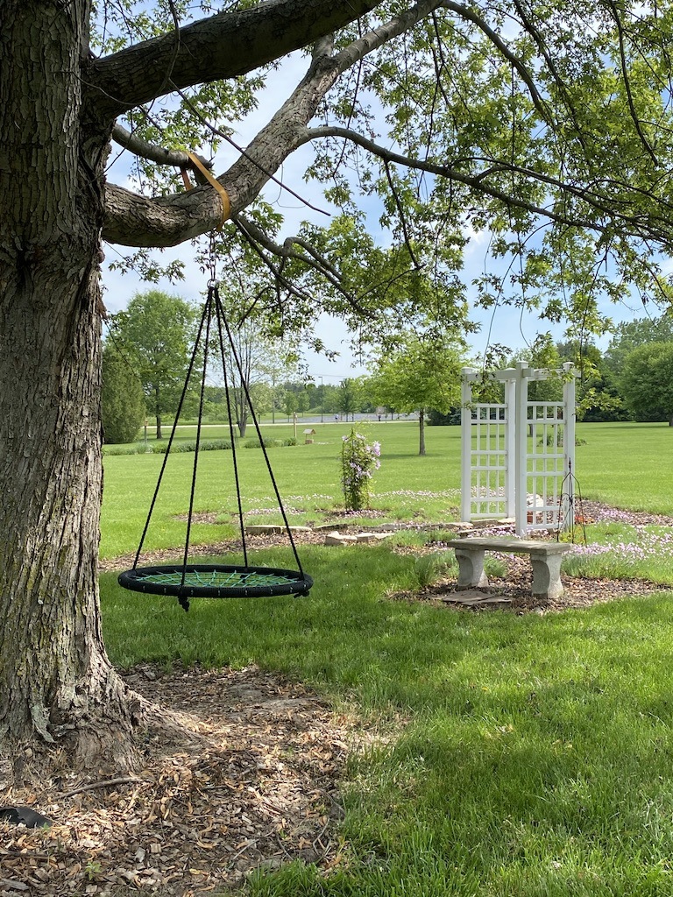
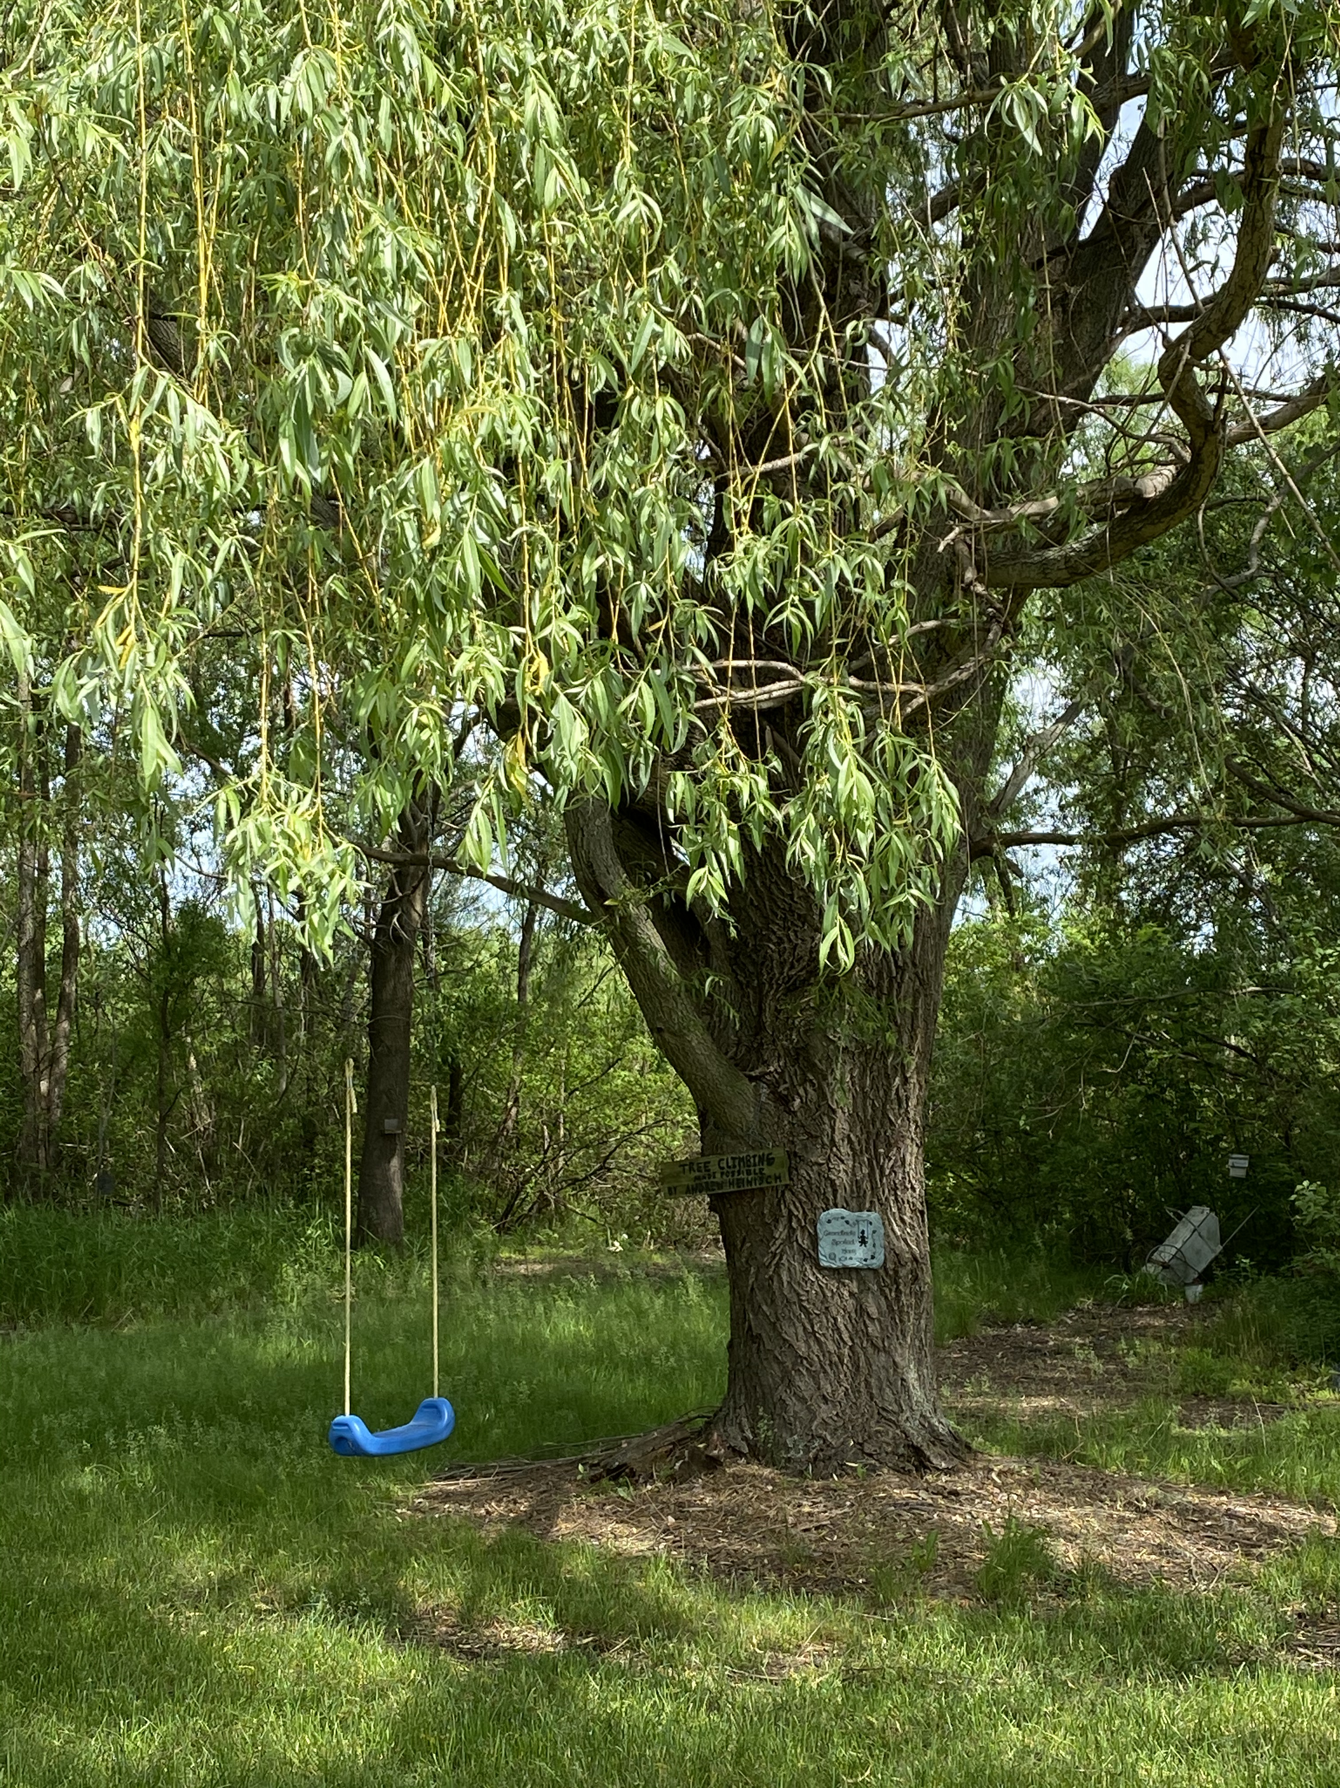
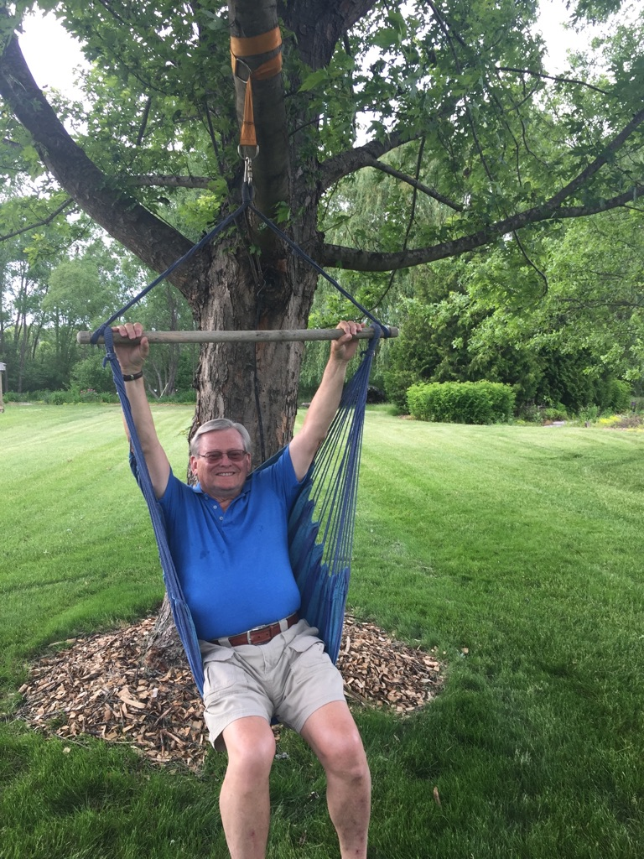
Everyone will have different plans for play.
Notes:
My favorite plan for play is evident in the 3 swings in my yard…….and the past treasurer of AATH seems to be in one of them.
Yep—Don and I are real swingers. We actually get on our swings at the end of the day, swing and then enjoy conversation and reflection…..
Play is more fun when you do it with friends and family and that is why we so appreciate our AATH family!

Slide 9
Take a Minute to Plan for Play
Notes:
Like anything else----it takes a commitment to find the time to include play in your life. .
How do you plan to take the leap and add some play in your life?
Review the handout and for more ideas and post on social media about you plan to incorporate play in your life.

Slide 10
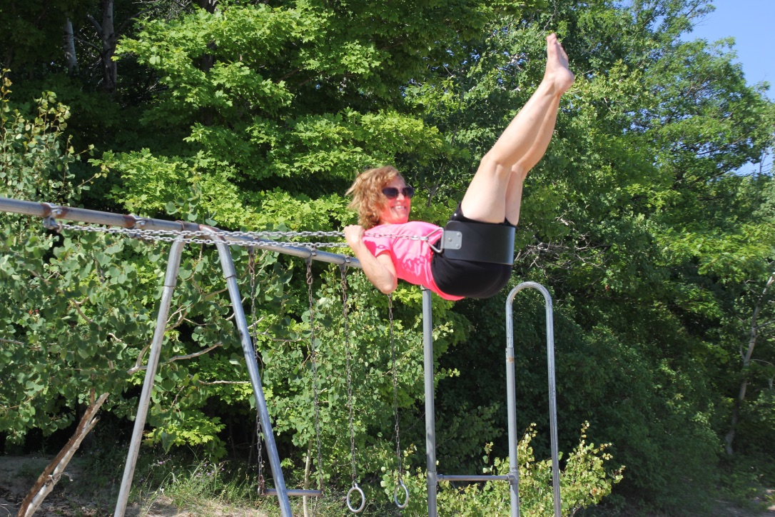
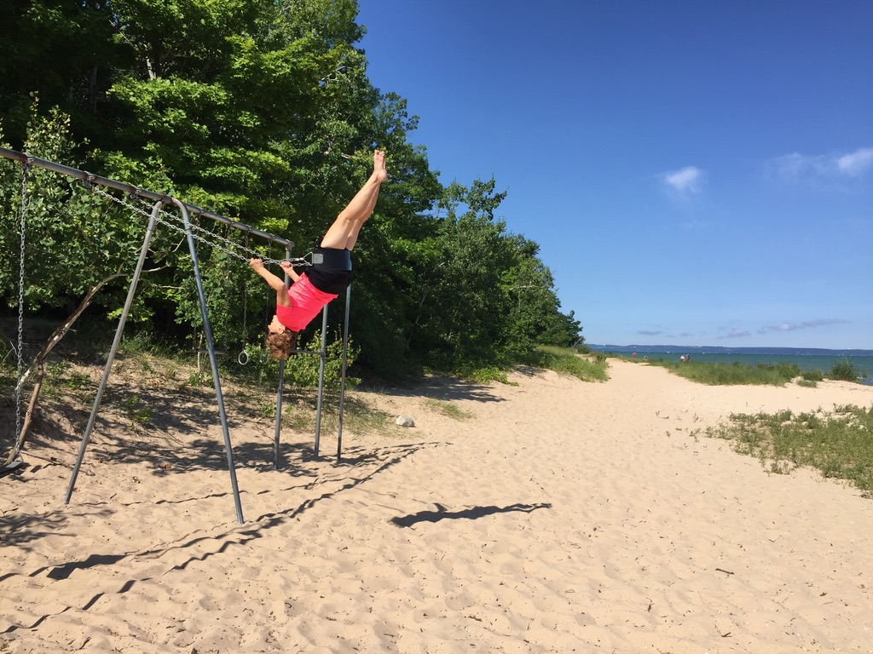
Humor Quest
Mary Kay Morrison
Marykay@questforhumor.com
www@questforhumor.com
@marykaymorrison
Notes:
Thanks for joining this real swinger……Have a great conference and thanks to Megan and Mallori for all of your work!
A very special thanks to Jennifer Keith for technical assistance.

